Slide 1




MINOR PROJECT 2-RESISTER MODELING
NAME : CHANDAN SHUKLA
ROLL NO. : 231040038

Slide 2
DATA SCREENING
Resistance depends on temperature is given by-
R(T) = R(Tref)=( 1 + Tc1δT + TC2δT² )
Contact and end regions have different temperature coefficients than resistor body. So,
Rtot = 2 REWC/Wm (1 + T_{c1E}δT + T_{C2E}δT² )+ p_{s} L/ W (1 + T_{c1B}δT + T_{C2B}δT² )
Assuming 2R_{EWC}≪ p_{s} L,
Rtot(T)/Rtot (T_{ref}) = 1 +[ Tc1B + 2R_{EWC} (T_{c1E} − Tc1B)/ p_{s}L] δT + [T_{c2B} + 2R_{EWC} (T_{c2E} − T_{c2B}) p_{s}L ]δT2

Slide 3
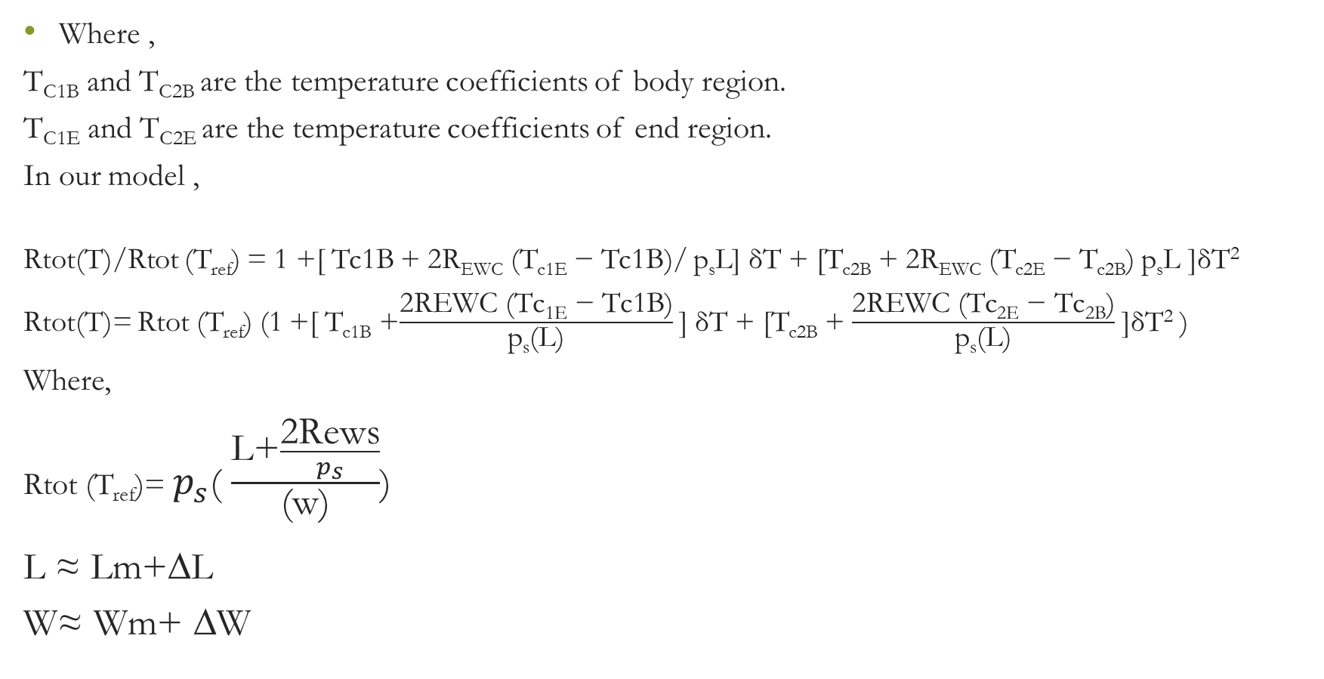
Where ,
T_{C1B} and T_{C2B} are the temperature coefficients of body region.
T_{C1E} and T_{C2E} are the temperature coefficients of end region.
In our model ,
Rtot(T)/Rtot (T_{ref}) = 1 +[ Tc1B + 2R_{EWC} (T_{c1E} − Tc1B)/ p_{s}L] δT + [T_{c2B} + 2R_{EWC} (T_{c2E} − T_{c2B}) p_{s}L ]δT²
Rtot(T)= Rtot (T_{ref}) (1 +[ T_{c1B} +$\frac{\text{2}\text{REWC}\text{ (}\text{Tc}\text{1}\text{E}\text{ − }\text{Tc}\text{1}\text{B}\text{)}}{\text{p}\text{s}\text{(}\text{L}\text{)}}$ ] δT + [T_{c2B} + $\frac{\text{2}\text{REWC}\text{ (}\text{Tc}\text{2}\text{E}\text{ − }\text{Tc}\text{2}\text{B}\text{)}}{\text{p}\text{s}\text{(}\text{L}\text{)}}$ ]δT² )
Where,
Rtot (T_{ref})= $p_{s}$( $\frac{\text{L}\text{+}\frac{\text{2}\text{Rews}}{p_{s}}}{\text{(}\text{w}\text{)}}$)
_{L ≈ Lm+∆L}
_{W≈ Wm+ ∆W}

Slide 4

From model card-
Length is given as – oplen = max(plnom,2u) + nddlf
L ≈Lm+∆L
Width :
opwdth = max(w,1u) + nddwf
W= Wm+∆W
* Resistance calculation
+ rmid = ndrsf * (oplen / opwdth) / 2
Rmid= $P_{s}\frac{L}{2W}$
+ rend = (ndrenf / opwdth)
Rend=$\frac{R_{EWC}}{W_{m}}$

Slide 5

final resistance modelled is-
R_{total}(T)= $R_{body}+R_{end}$
R_{total}(T)= $P_{s}\frac{L}{W}$ ( 1+$T_{C1B}δ$T) + $\frac{R_{EWC}}{W_{m}}$ (1+$T_{C1B}δ$T)
[δT= T – T_{ref} ] Tref=tnom=25$℃$
We have given parameters which we have to tune are-
Variation in width $\text{∆}$w = nddwn
Variation in length $\text{∆}$L = nddln
Sheet resistance(in ohm/square) $p_{s}$ = ndrsn
Voltage coefficient $V_{C1}$= ndvcr
Tem. Coff. For body region $T_{C1B}$ = ndrstc
Tem. Coff. For end region $T_{E1b}$ = ndrntc

Slide 6

Voltage dependency of resistance is also given by
R(V) = $R_{0}$ $\left(1+ V_{C1}V\right)$
R(V) = [ $P_{s}\frac{L}{W}$ ( 1+$T_{C1B}δ$T)+ $\frac{R_{EWC}}{W_{m}}$ (1+$T_{C1B}δ$T)] $(1+ V_{C1}V)$
Based on given equations we can conclude that
R_{total} $∝∆$L R_{total} $∝ V_{C1}$ R_{total} $∝p_{s}$
R_{total} $∝\frac{1}{∆W}$

Slide 7
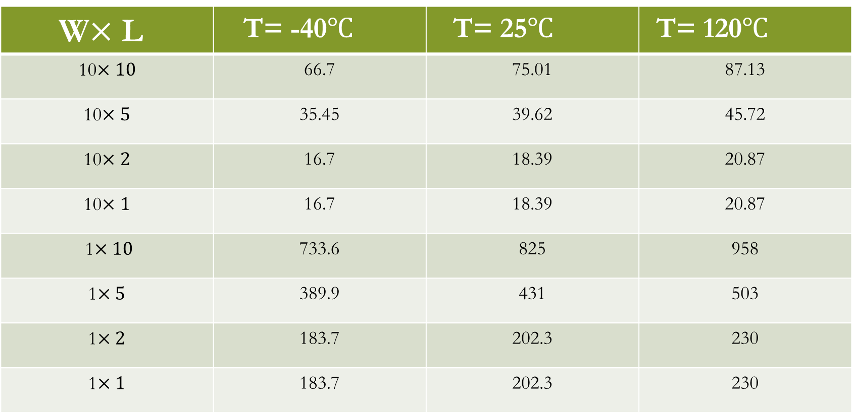
Measured resistance(in ohm) from different geometry's
W$×$ L | T= -40$℃$ | T= 25$℃$ | T= 120$℃$
10$×10$ | 66.7 | 75.01 | 87.13
10$×5$ | 35.45 | 39.62 | 45.72
10$×2$ | 16.7 | 18.39 | 20.87
10$×1$ | 16.7 | 18.39 | 20.87
1$×10$ | 733.6 | 825 | 958
1$×5$ | 389.9 | 431 | 503
1$×2$ | 183.7 | 202.3 | 230
1$×1$ | 183.7 | 202.3 | 230

Slide 8
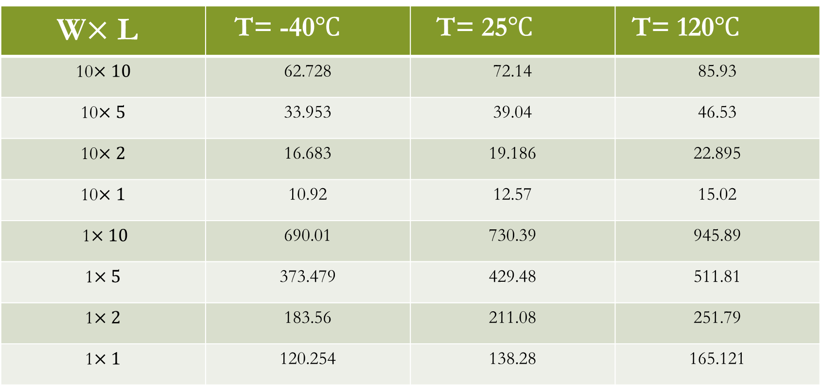
Calculated resistance(in ohm) using formula and given data
W$×$ L | T= -40$℃$ | T= 25$℃$ | T= 120$℃$
10$×10$ | 62.728 | 72.14 | 85.93
10$×5$ | 33.953 | 39.04 | 46.53
10$×2$ | 16.683 | 19.186 | 22.895
10$×1$ | 10.92 | 12.57 | 15.02
1$×10$ | 690.01 | 730.39 | 945.89
1$×5$ | 373.479 | 429.48 | 511.81
1$×2$ | 183.56 | 211.08 | 251.79
1$×1$ | 120.254 | 138.28 | 165.121

Slide 9
Graphs for measured data

Slide 10
Graphs of calculated data

Slide 11
CONCLUSION
Based on given equation and model we have plot both experimental and measured data and find a similar behavior.
Using data in measurement and formulas I have try to minimise the RMS error and plot this for all geometry at every temperature.

Slide 12
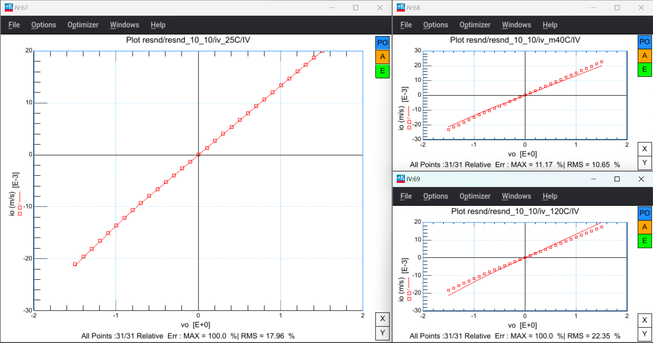

Slide 13
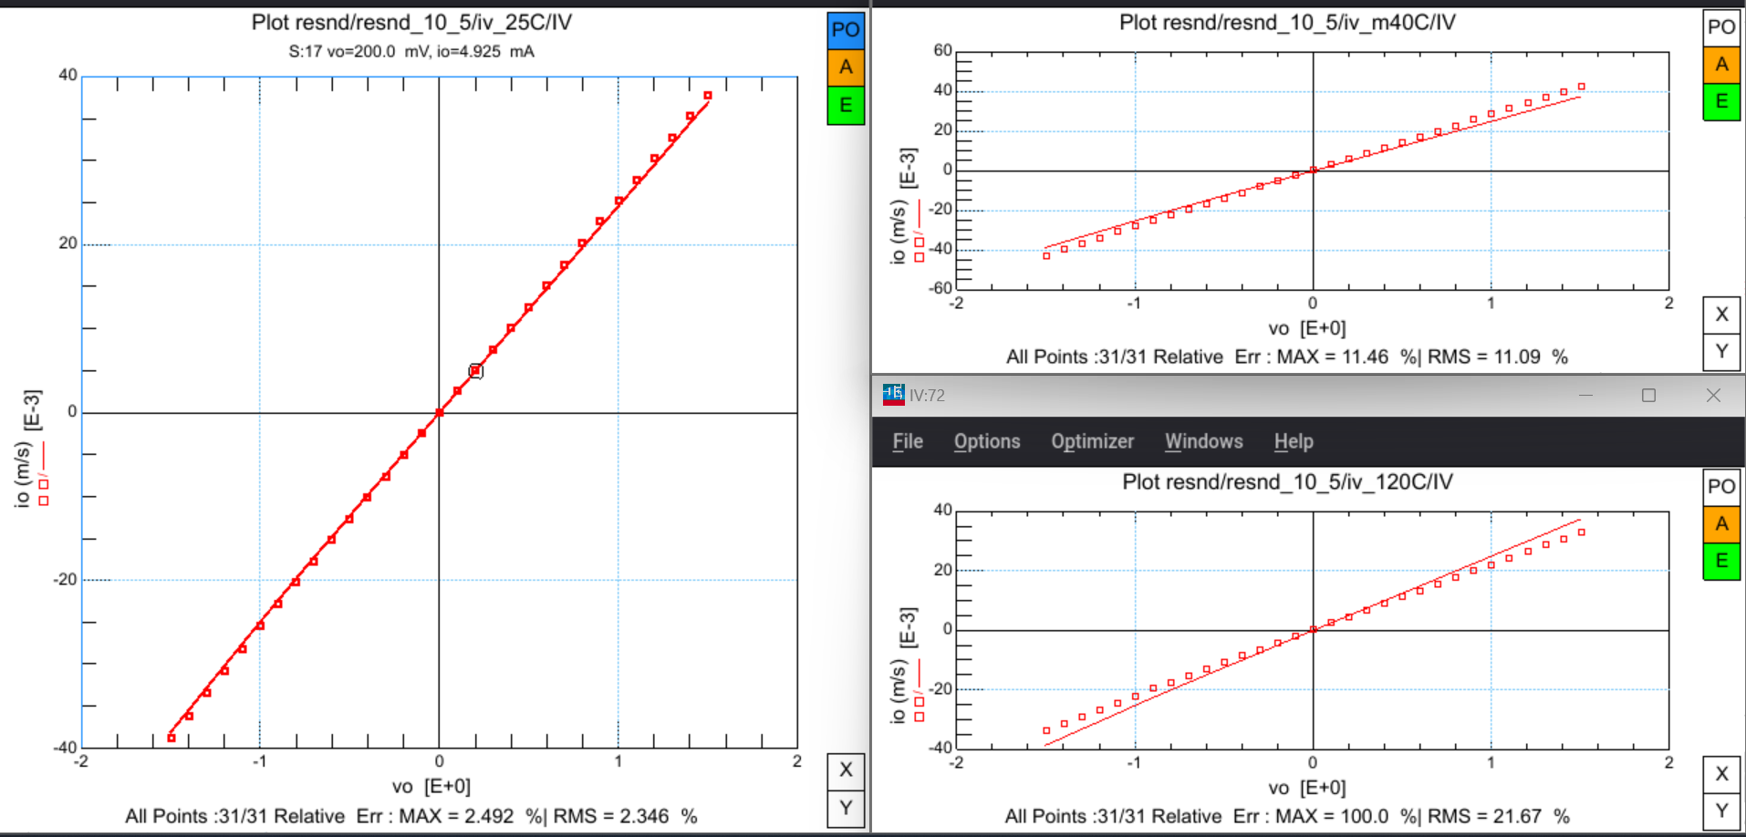

Slide 14
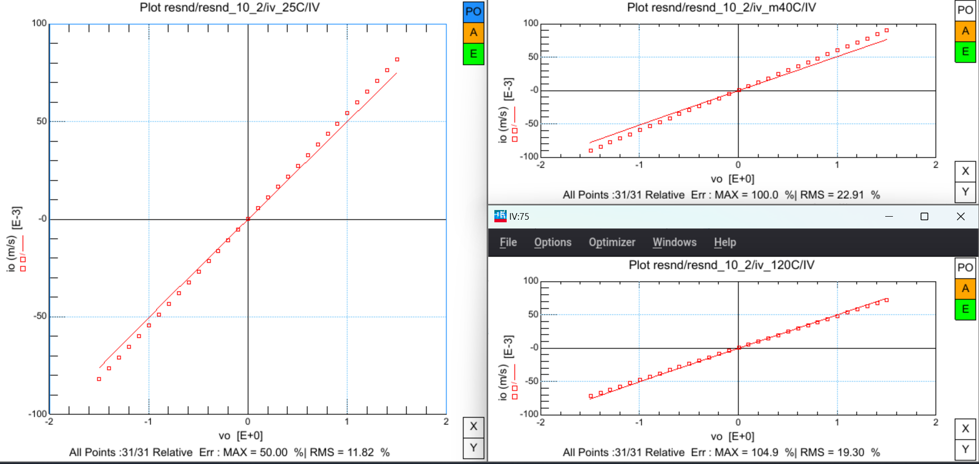

Slide 15
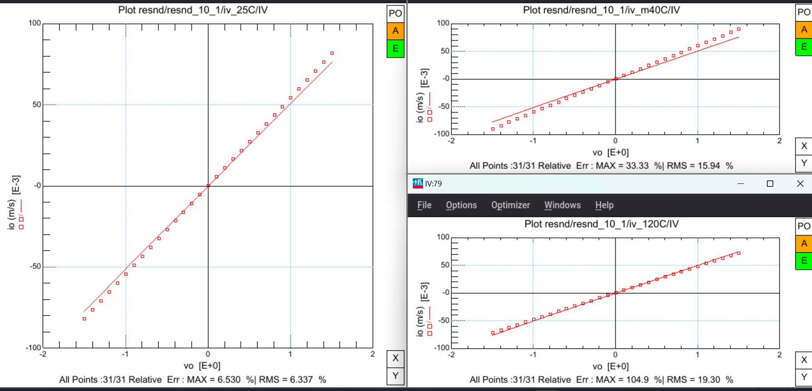

Slide 16
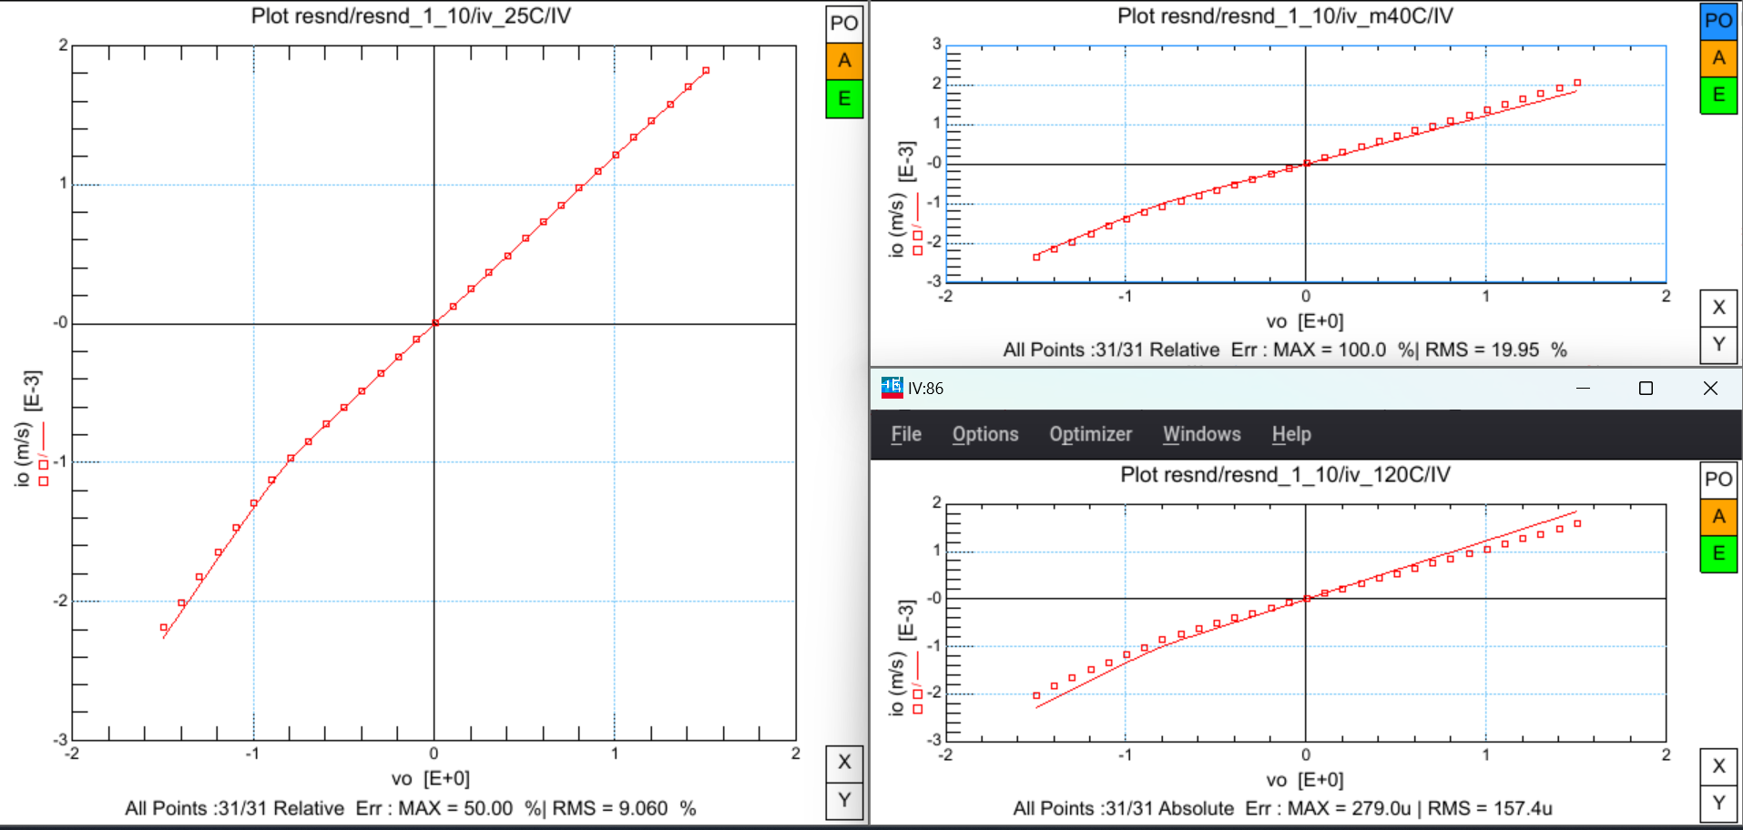

Slide 17
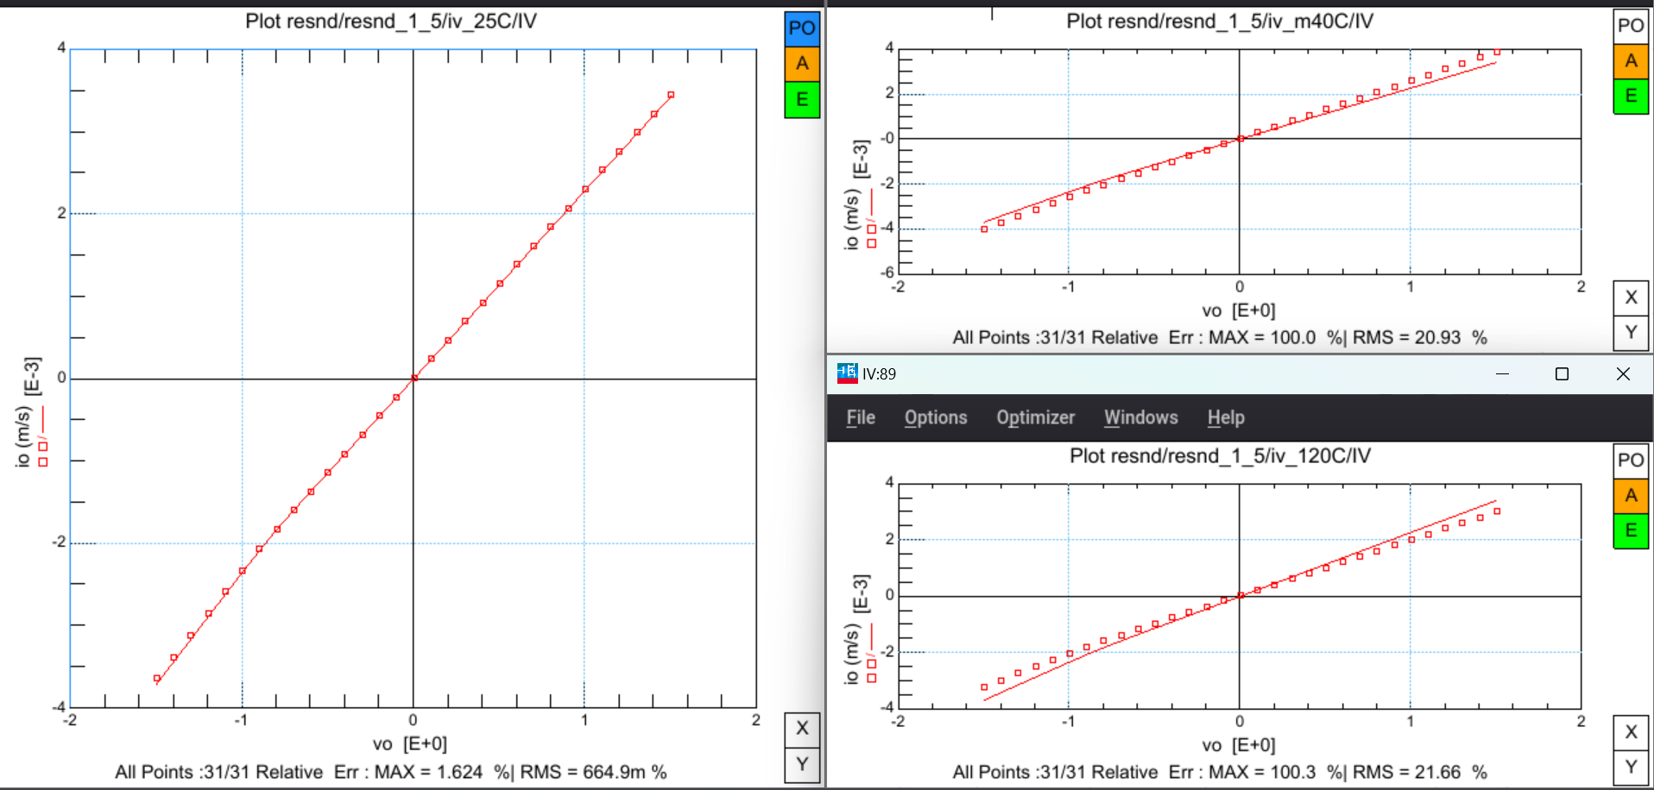

Slide 18
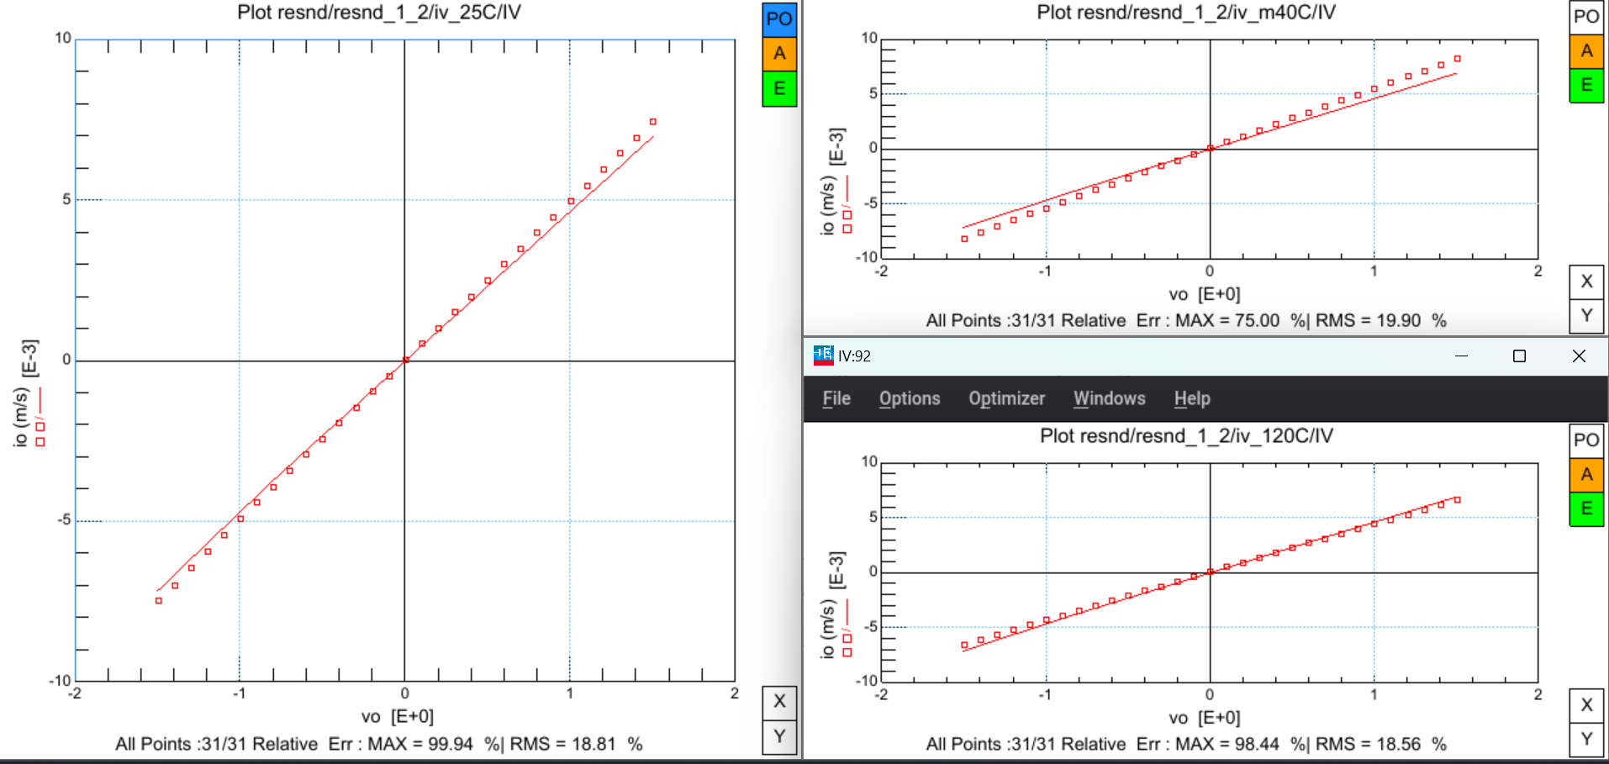

Slide 19
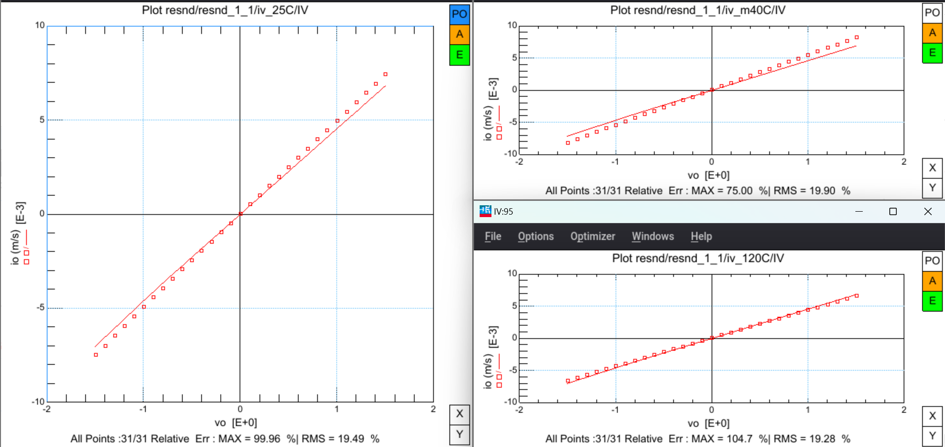

Slide 20
Comparison of data
S.NO | Parameter | Previous value | New value
1. | nddwn | -100.0n | -100.0n
2. | ndrenn | 54.88n | 65.00n
3. | ndrsn | 65.43 | 67.86
4. | nddln | 898.7n | 898.7n
5. | ndrstc | 2.006m | 2.000m
6. | ndrntc | 131.7u | 131.0u
7. | ndvcr | 1.050m | 1.050m

